Slide 1

Fraud Detection in Healthcare Providers using Machine Learning
Presented by DataOrbit Healthcare Provider Fraud Detection Team

Slide 2

The Growing Challenge of Healthcare Fraud
Healthcare fraud is a pervasive issue, costing billions of dollars annually and diverting critical resources from patient care. Our project, DataOrbit Healthcare Provider Fraud Detection, aims to combat this problem by identifying fraudulent Medicare providers using advanced machine learning techniques. The primary challenge lies in the severe class imbalance inherent in fraud detection, where only approximately 10% of cases are genuinely fraudulent.

Slide 3


Dataset Overview: Unpacking the Data
Our analysis leverages the comprehensive Kaggle Healthcare Provider Fraud Detection dataset, which comprises four interconnected tables: Beneficiary, Inpatient Claims, Outpatient Claims, and Labels.
Dataset Structure
Key Identifiers
Composed of four distinct tables for comprehensive analysis.
BeneID for beneficiaries and Provider for healthcare providers are crucial for linking information.
Modeling Unit
The primary unit of analysis is at the individual provider level.

Slide 4

Initial Data Exploration: Identifying Key Patterns
During our initial data exploration, we uncovered several critical patterns and anomalies. We observed significant missing values in chronic condition data, necessitating careful imputation strategies. Furthermore, we identified numerous outliers in claim amounts, which required robust handling to prevent model bias. Notably, fraudulent providers exhibited distinct characteristics:
Significantly higher claim counts.
Elevated average claim amounts.
A disproportionately higher number of inpatient claims per beneficiary.

Slide 5



Fraud Distribution: Understanding Class Imbalance
A critical aspect of this dataset is the stark class imbalance, a common characteristic in fraud detection. This imbalance presents significant challenges for traditional machine learning models, which often struggle to accurately identify the minority class.
Fraudulent Providers
506 providers (9.35%)
Non-Fraudulent Providers
4904 providers (90.65%)
Imbalance Ratio
Approximately 9.7:1

Slide 6
Feature Engineering: Crafting Predictive Signals
To enhance our model's predictive power, we engineered a rich set of provider-level features by aggregating data from the various tables. These features capture diverse aspects of provider behavior and patient interactions.
1
2
3
Count Features
Financial Features
Beneficiary Features
Total number of claims, unique beneficiaries, and unique services.
Mean, sum, and maximum claim amounts, providing insights into billing patterns.
Aggregated chronic condition counts per provider, reflecting patient profiles.
4
5
Ratios
Temporal Features
Inpatient to outpatient claim ratios, and claims per beneficiary to detect unusual activity.
Claim duration and average hospital stay length, capturing time-based patterns.

Slide 7

Mitigating Class Imbalance: A Strategic Approach
Addressing class imbalance is paramount in fraud detection to ensure the model does not simply predict the majority class. We rigorously tested various techniques, each with its own advantages and disadvantages.
SMOTE
Undersampling
Synthetic Minority Over-sampling Technique to generate synthetic samples of the minority class.
Reducing the number of samples in the majority class to balance the dataset.
Class Weights
Assigning higher penalty to misclassified minority samples during model training.
Ultimately, class-weighted models emerged as the most effective strategy, providing a superior balance between precision and recall, which are critical metrics in fraud detection.

Slide 8
Model Performance: A Comparative Analysis
We evaluated several machine learning models to identify the most robust solution for healthcare fraud detection. The table below summarizes their performance across key metrics, highlighting the strengths and weaknesses of each approach.
Model
Accuracy
Precision
Recall
F1
ROC_AUC
PR_AUC
Logistic Regression
0.90
0.48
0.90
0.63
0.97
0.79
Random Forest
0.95
0.83
0.60
0.70
0.97
0.78
Decision Tree
0.91
0.50
0.79
0.61
0.87
0.52
SVM
0.90
0.47
0.89
0.62
0.95
0.58
XGBoost
0.95
0.71
0.71
0.71
0.96
0.78
XGBoost consistently demonstrated strong performance across all metrics, particularly in balancing precision and recall.

Slide 9
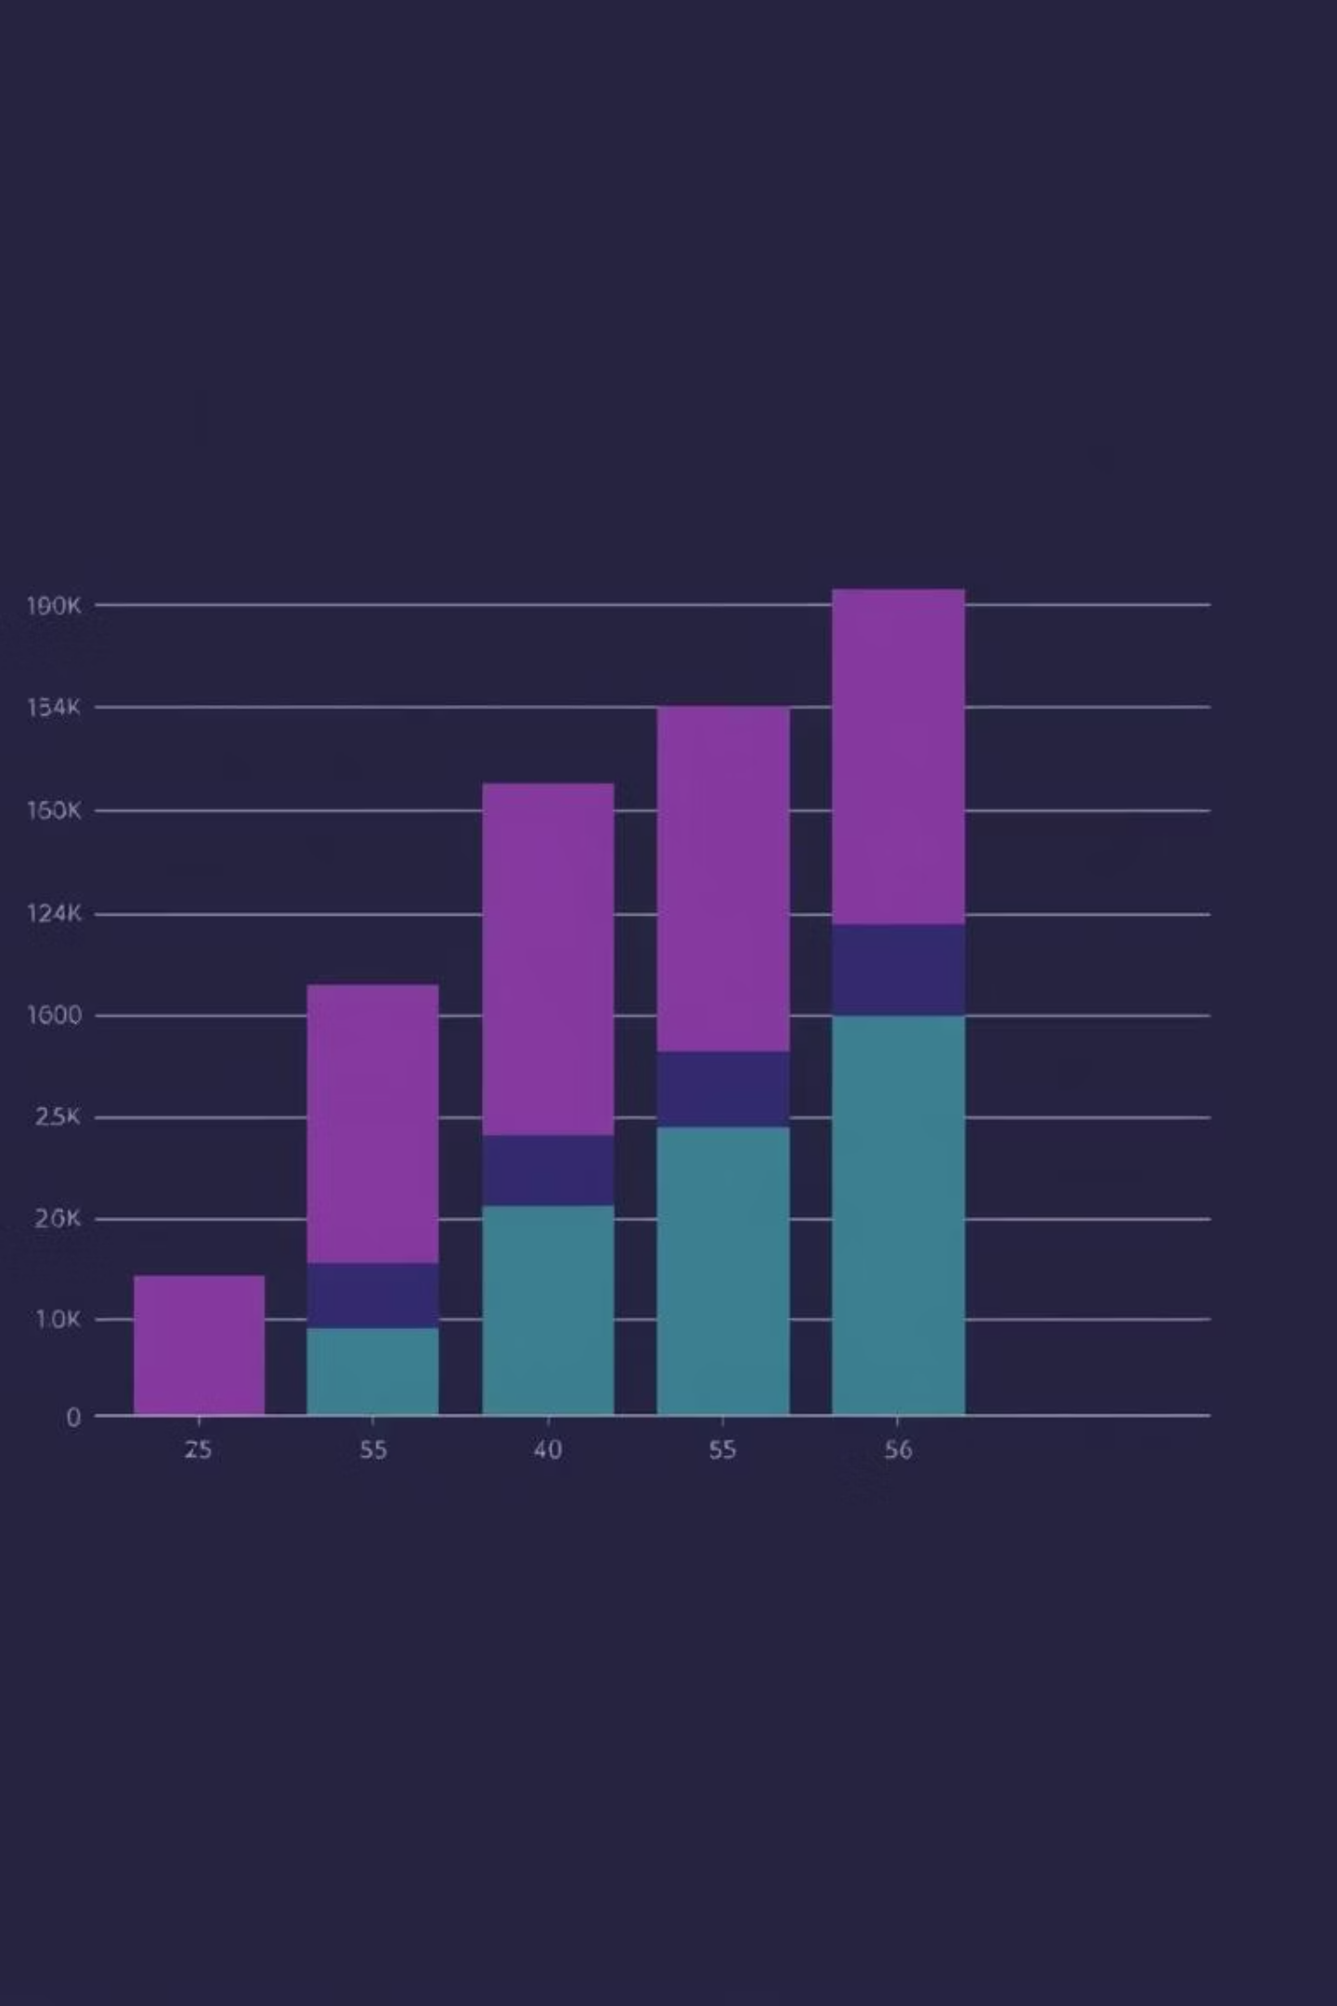
XGBoost: The Optimal Choice for Fraud Detection
Based on our comprehensive model comparison, XGBoost emerged as the clear winner for the DataOrbit Healthcare Provider Fraud Detection project. Its robust performance and inherent capabilities make it ideally suited for the complexities of healthcare fraud.
Balanced Performance
Achieved the best balance between precision and recall, crucial for fraud detection.
Non-Linearity
Effectively captures complex, non-linear relationships within the data.
Imbalance Handling
scale_pos_weight parameter allows direct handling of class imbalance.
Interpretability
Provides valuable feature importance scores, aiding in understanding model decisions.

Slide 10
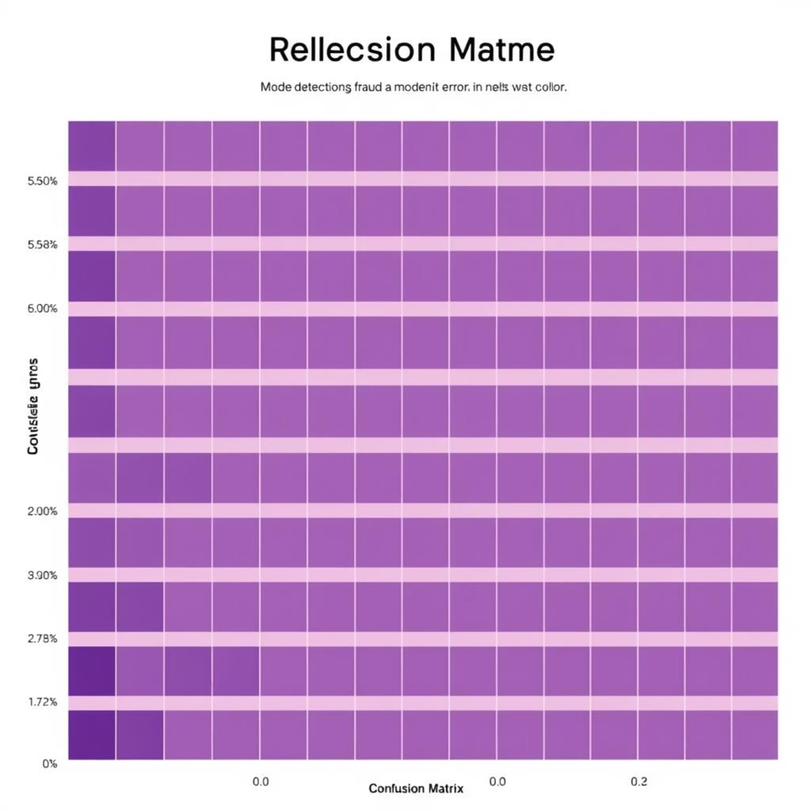
Continuous Improvement: Evaluation & Error Analysis
Our ongoing evaluation and error analysis are critical for refining the model and addressing its limitations. We identified common characteristics of false positives and false negatives, which guide our future improvements.
False Positives
Complex demographic profiles.
High incidence of chronic conditions.
Varied treatment plans.
False Negatives
Low-amount, repeated claims.
Physician-sharing patterns.
Sophisticated fraud schemes.
Future Enhancements
Integrating temporal stability metrics.
Implementing age-adjusted claim rates.
Developing graph-based features for network analysis.

